Slide 1
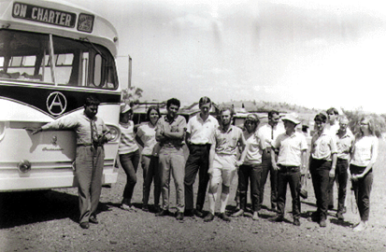
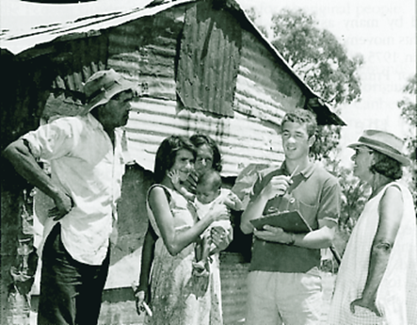
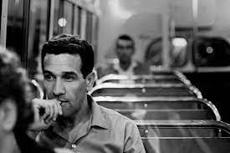
Charles Perkins & The Australian Freedom Rides, 1965
Learning Intention:
To investigate the Australian Freedom Rides

Slide 2
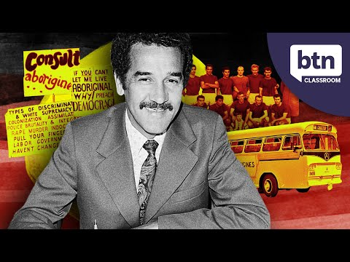
What were the Australian Freedom Rides?
“In 1965, a group of students from the University of Sydney drew national and international attention to the appalling living conditions of Aboriginal people and the racism that was rife in New South Wales country towns. Known as the Freedom Ride, this 15-day bus journey through regional New South Wales would become a defining moment in Australian activism.”
(aiatsis.gov.au, 2021)
4 mins

Slide 3
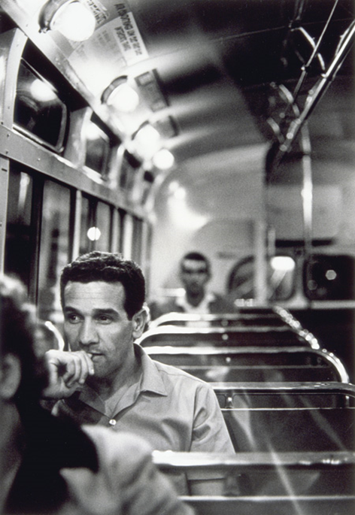
Who was Charles Perkins?
Charles Perkins was born in Alice Springs 1936.
He went to boarding school in Adelaide age 10
A gifted soccer player he played professionally in both Australia and UK.
He gave up playing for the English 1st grade to return to Australia to become the 1st Aboriginal student at Sydney Uni.
He was inspired by the Freedom Rides USA 1961

Slide 4
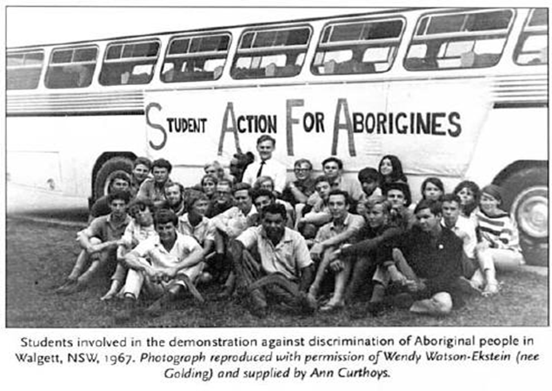
Student Action For Aborigines
Charles Perkins became the first Aboriginal person to graduate from Sydney University.
In 1964 he founded SAFA to campaign for Aboriginal rights around NSW.

Slide 5
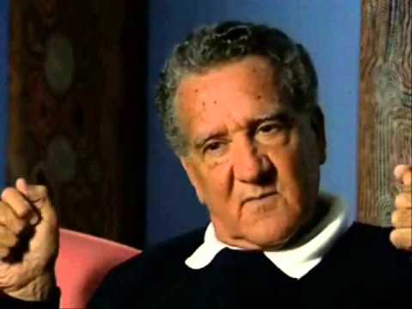
Charles Perkins on the Freedom Rides
The Freedom Rides were designed to raise awareness of injustice towards Aboriginal people.
Expose the segregation and poor living conditions Aboriginal Australians had to endure.
2 mins

Slide 6
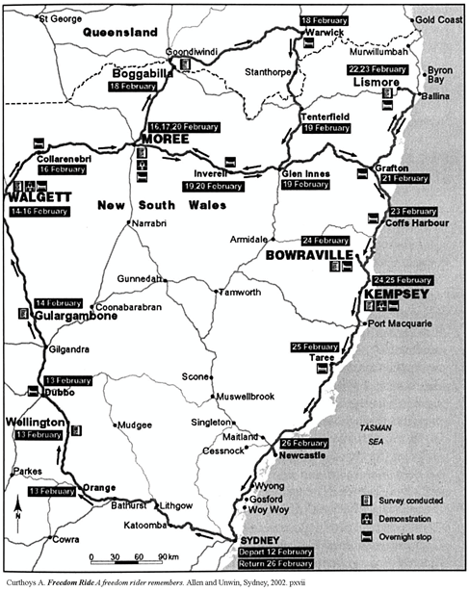
The Freedom Route
The SAFA students were a mixed group of men and women , some were Communists others were Christians,- All 29 wanted justice for Aboriginal people.
Their route included West and Northern NSW and Goondiwindi in Queensland.
Map Source: Curthoys A. Freedom Ride A Freedom rider remembers. Allen and Unwin, Sydney, 2002

Slide 7
Early stages of the Freedom Rides
“12th February 1965 - The Freedom Rides set off from Sydney at night on the 12th of February 1965 with a bus load of students 30, primarily from Sydney University.
13th February 1965 - First stop of the bus tour was Wellington. No protests were carried out, but surveys were carried out which affirmed views on Aboriginal discrimination. Aboriginal and white living standards were also taken note of.
14th February 1965 - Again, no protests were carried out and surveys were taken of living standards, etc. The results showed the overt discrimination shown against Aborigines, and concluded that the local population were actively segregating Aborigines and denying them access to rights and facilities.” [locations Dubbo to Gulargambone]
(Charles-perkins, 2009)

Slide 8
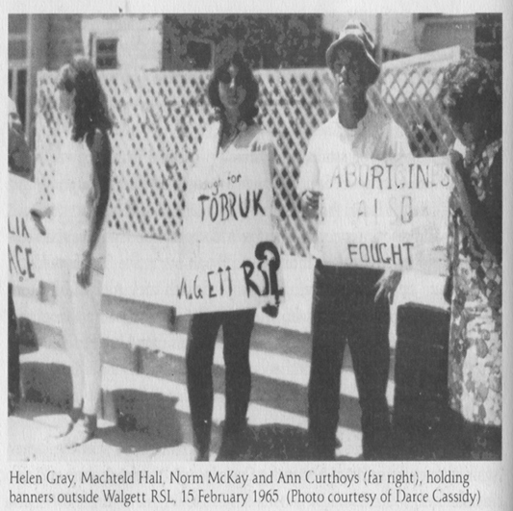
Walgett - Returned Servicemen’s League
The RSL club was the basis and symbol of the Australian ANZAC legend, which personified mateship, courage and nationhood.
However, this hospitality was not extended to Aboriginal ex-servicemen, who were only allowed to use RSL facilities on ANZAC day, or in worse cases not allowed in at all.
This protest was covered by the media which led to public pressure on the local council to amend the law.
By afternoon some Aboriginal people joined the protest
The protesters were run out of town and the bus run off the road.
Notes:
http://charles-perkins.wikidot.com/freedom-ride-accomplishments

Slide 9
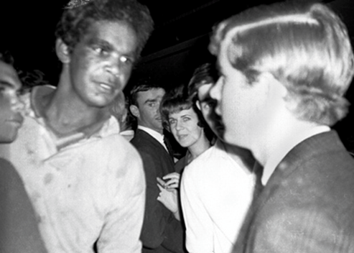
Walgett - Cinema
The Cinema at Walgett was segregated- Blacks and Whites could not sit together.
The Freedom Riders went to the movies Black and White together – They were arrested.

Slide 10
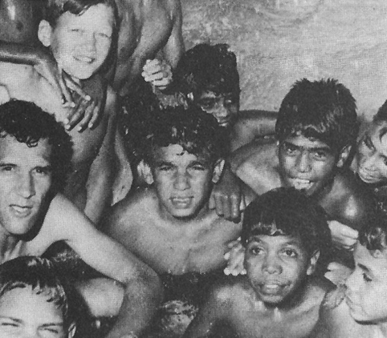
Moree - Swimming Pool
Moree – Aboriginals were banned from the pool. The Freedom Riders took kids from the mission and talked the management into letting them in.
This is a photo of Charles Perkins swimming with the kids in Moree.
But was it going to last????????

Slide 11
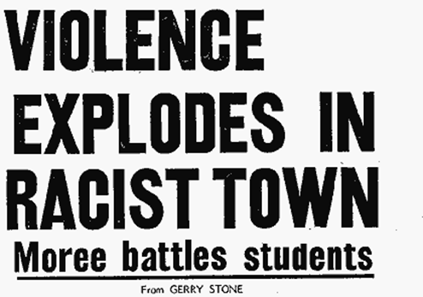
Moree Riot 1965
The bus left Moree
The protestors rang to see if the pool was still OK for Aboriginal people. ...Bad news
When the bus left – Aboriginal kids were banned again!
The bus went back and there was a riot
Aboriginal people were not allowed into the pool. Protestors were arrested
Headline Source: Sydney Daily Mirror, 21 February 1965
Notes:
https://www.nma.gov.au/__data/assets/pdf_file/0009/697158/violence-explodes-in-racist-town.pdf

Slide 12
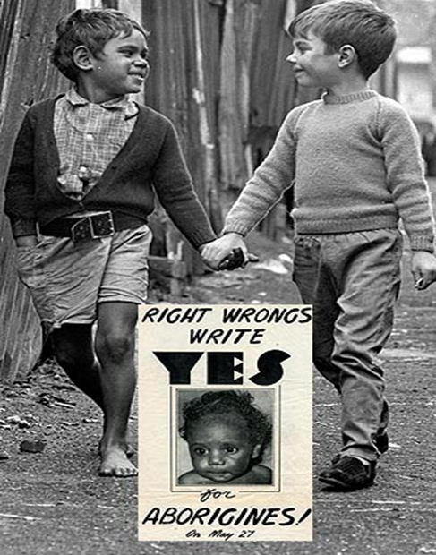
Outcomes
The actions of SAFA attracted a great deal of publicity both in Australia and overseas.
People in the cities became aware of the serious problems faced by Aboriginal people in the bush.
Credited with the breakdown of the White Australia Policy
The Rides generated many opposition groups among white, conservative rural populations
The Rides were sometimes blamed for stirring up short term troubles in small communities and then leaving without having to deal with the consequences

Slide 13
Referendum
This high profile campaign contributed to the campaign for a referendum to right wrongs against Aboriginal people.
The referendum had 2 questions
Should Aboriginals be counted in the census?
Should the Federal government have responsibility for laws on Aboriginal people?
Over 90% voted YES on May 27 1967

